Slide 1


Hill Cipher
m successive plaintext letters are substituted by m ciphertext letters.
If, a = 0, b = 1, …, z = 25. For m = 3
c₁ = (k₁₁p₁ + k₁₂p₂ + k₁₃p₃) mod 26
c₂ = (k₂₁p₁ + k₂₂p₂ + k₂₃p₃) mod 26
c₃ = (k₃₁p₁ + k₃₂p₂ + k₃₃p₃) mod 26

Slide 2
Polyalphabetic Ciphers
One plaintext character for its multiple occurrences, may generate different cipher text characters

Slide 3

Example of Vigenere Cipher
using keyword deceptive
  key: deceptivedeceptivedeceptive
  plaintext: wearediscoveredsaveyourself
  cipher text: ZICVTWQNGRZGVTWAVZHCQYGLMGJ

Slide 4
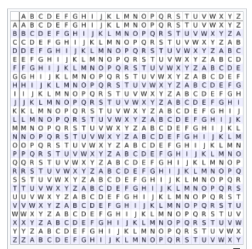
Vigenere Table or Vigenere Square

Slide 5
Vigenere Encryption using Vigenere Square
Example:
Plain text: SHEISLISTENING
Key : PASCAL
Generate Key Stream such that key size is equal to Plaintext size
Plain text: S HEI SLI ST ENI NG
KEY stream: PASCALPASCAL P A
Refer Plain text letter row and Key letter Column in Vigenere square
Plain text letter S(row)
Keystream letter P(column)
Intersection letter of above row and column is ‘h’
Therefore CT of plain text letter ‘s’ is ‘h’ and so on.

Slide 6
Vigenere Encryption using Vigenere Square
Decryption in Vigenere Cipher using Vigenere Square:
Take Key letter as column (in example P row)
In that key column search for Cipher text letter (in example ‘h’)
Return that ciphertext letter’s row value( in Key letter ‘p’ column) as Plain text letter.
As per example ‘s’

Slide 7
Security of Vigenere Ciphers
This scheme is vulnerable to cryptanalysis. Because the key and the plain text share the same frequency distribution of letters, a statistical analysis can be applied.

Slide 8
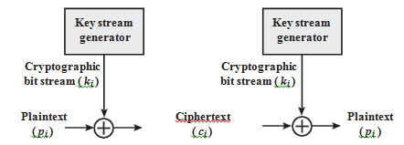
Vernam Cipher
c_{i} = p_{i} Ⓧ k_{i} where,
p_{i} = i th binary digit of plaintext
k_{i} = ith binary digit of key
c_{i} = ith binary digit of ciphertext
Ⓧ = exclusive-or (XOR) operation
p_{i} = c_{i} Ⓧ k_{i}

Slide 9
One-Time Pad
The beauty of one-time pad is, for same ciphertext the plain text is different if key is different.
ciphertext: ANKYODKYUREPFJBYOJDSPLREYIUNOFDOIUERFPLUYTS
key: pxlmvmsydofuyrvzwc tnlebnecvgdupahfzzlmnyih
plaintext: mr mustard with the candlestick in the hall
ciphertext: ANKYODKYUREPFJBYOJDSPLREYIUNOFDOIUERFPLUYTS
key: mfugpmiydgaxgoufhklllmhsqdqogtewbqfgyovuhwt
plaintext: miss scarlet with the knife in the library

Slide 10
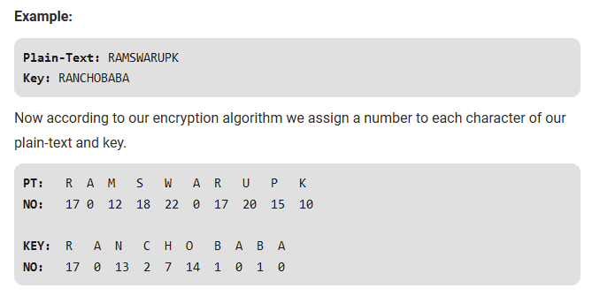
Onetime Pad

Slide 11
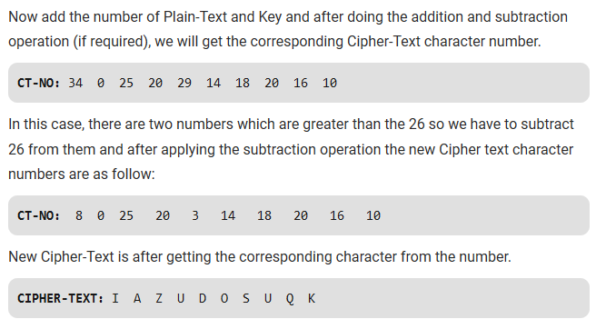
Onetime Pad

Slide 12
Transposition Ciphers
Rail fence technique
The plaintext is written down as a sequence of diagonals and then read as a sequence of rows.
Example,
Plain text: “meet me after the toga party”
with a rail fence of depth 2, we write the following:
  m e m a t r h t g p r y
  e t e f e t e o a a t
Ciphertext : MEMATRHTGPRYETEFETEOAAT
The rail fence is trivial to cryptanalyze

Slide 13
Row Transposition Ciphers
  Arrange the plain text row by row, and read column by column, but permute the order of the columns.
  The order of the columns then becomes the key.
  Plaintext = attackpostponeduntiltwoamxyz
  Key: 4312567
  Column Out 4 3 1 2 5 6 7
  Plaintext: a t t a c k p
  o s t p o n e
  d u n t i l t
  w o a m x y z
  Ciphertext: TTNAAPTMTSUOAODWCOIXKNLYPETZ
  The transposition cipher can be made significantly more secure by performing more than one stage of transposition.

Slide 14
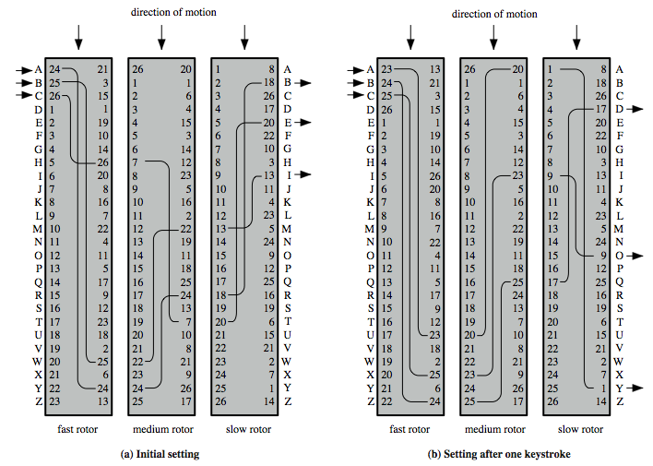
Rotor Machine

Slide 15
Rotor Machines
The result is that there are 26 * 26 * 26 = 17,576 different substitution alphabets used before the system repeats. The addition of fourth and fifth rotors results in periods of 456,976 and 11,881,376 letters, respectively.

